Slide 1

Roads Asset Editor
Tom Ryan
Fred Lott
Harkeerat Kang
WAGISA Conference
6.15.2023

Slide 2

What is Rae-Rae?
Custom application for Roads Division
Manage Roads asset inventory in unincorporated King County
System of record
Tracks 33 different type of Roads assets
ADA ramps, Barricades, Signs, Traffic cameras
Add new assets or updating existing assets

Slide 3

Modernization Effort
Replace Silverlight project
Silverlight is deprecated by Microsoft
Upgrade and rewrite application
Improve application performance
Responsive design (desktop/tablet/mobile)
Improve functional operations

Slide 4




Technologies Used
App built using React and Next.JS
ArcGIS Maps SDK for JavaScript 4.x
Uses Azure stack
Enterprise Geodatabase 10.9.1

Slide 5
Why custom application?
Using Linear Referencing
Route feature class with a defined measurement (m value)
Event tables contains info about assets, conditions and events located along route features
Dynamic segmentation
Uses a process to display assets from an event table on a map using route features measure
The routes are no longer needed to be split each time an attribute value changes.
You dynamically locate the asset on the segment
No SaaS or COTS applications available

Slide 6
Agile Methodology
Two week sprints followed by demos
Scrum Master and Project Manager from business
Product owner from Roads
Technical lead
Project development team
Yuko Caras, Matt Kozleski, Fred Lott, Tom Ryan, Harkeerat Kang
Lisa Owen, Jeff Gregg
Adam Cabrera
Michelle VanCooten, James Bach

Slide 7



Personas
Tina the Traffic Engineer
Randy the Roads Asset Installer
Mary the Maintenance Specialist
Roads Asset Supervisors
Roads Data Stewards
Roads Work Planning
Sign Installers
Signal Technician
Pavement Striper
Sidewalk & Curb Installer
Landscape Architect
General maintenance

Slide 8
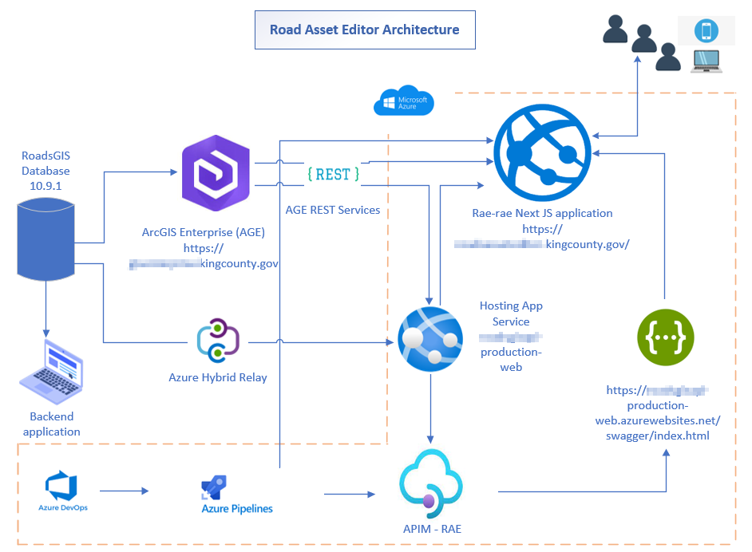

Slide 9
Interface tour

Slide 10
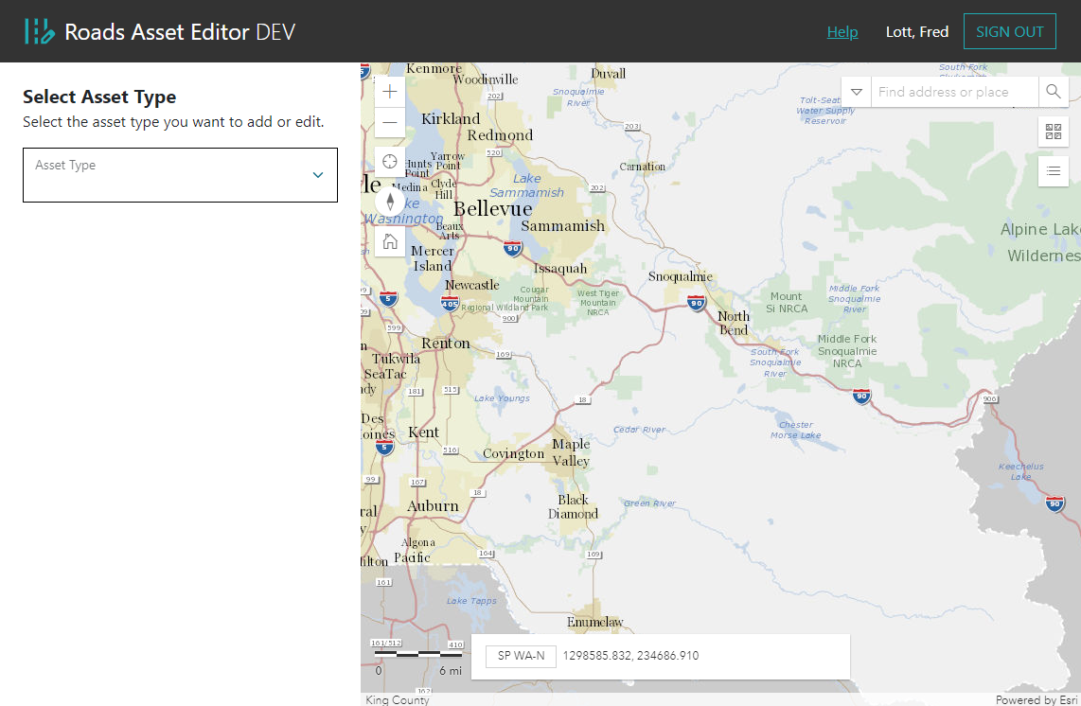
Interface slides (Fred)

Slide 11
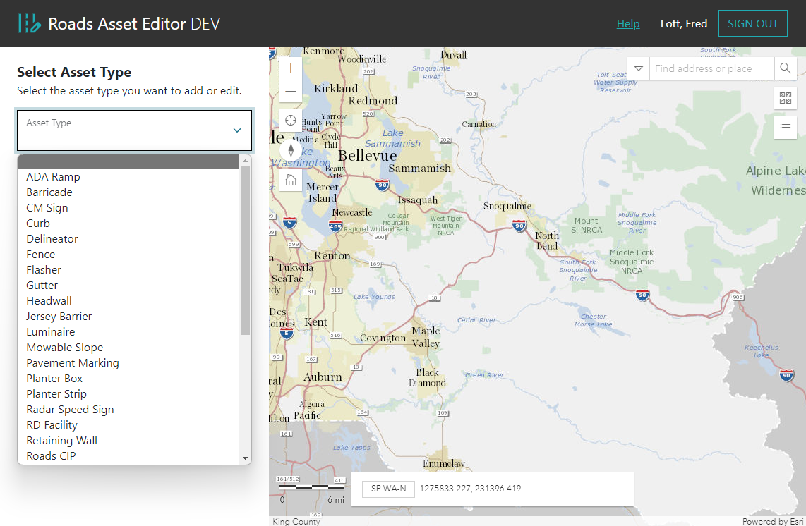
Interface slides (Fred)

Slide 12
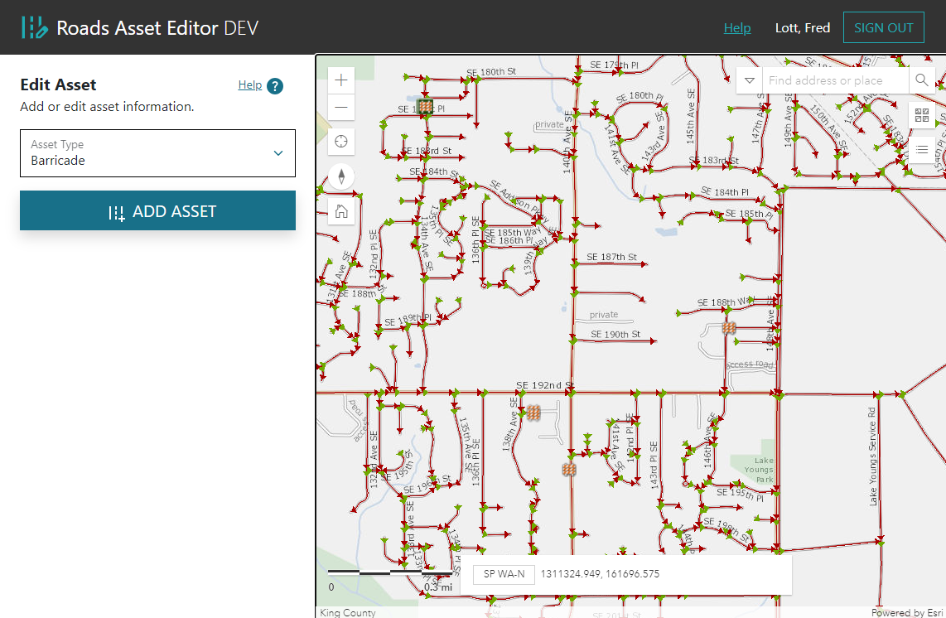
Interface slides (Fred)

Slide 13
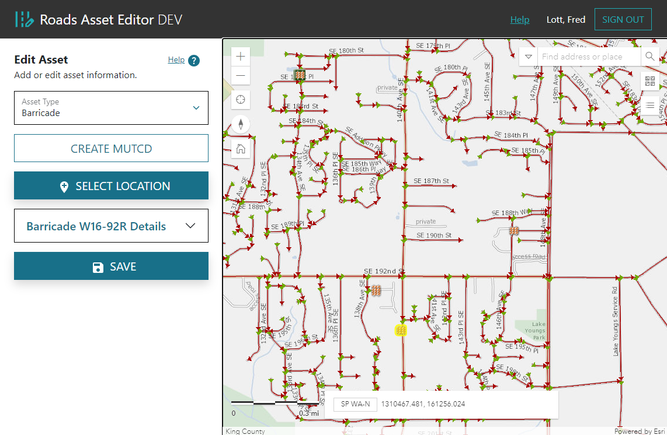
Interface slides (Fred)

Slide 14
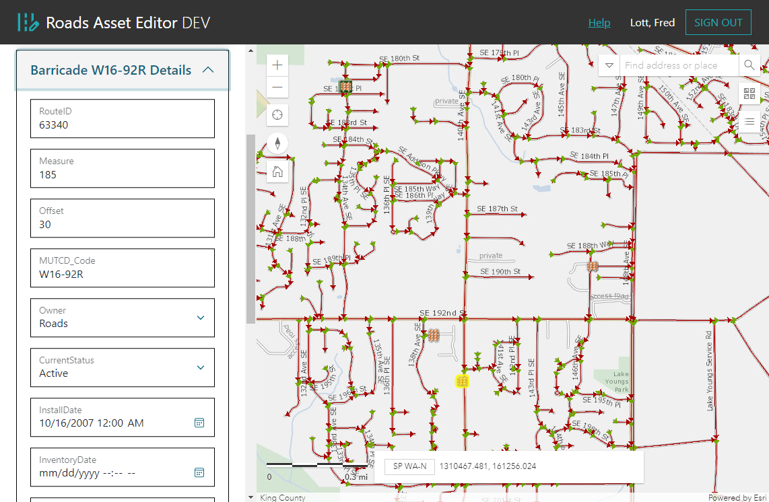
Interface slides (Fred)

Slide 15
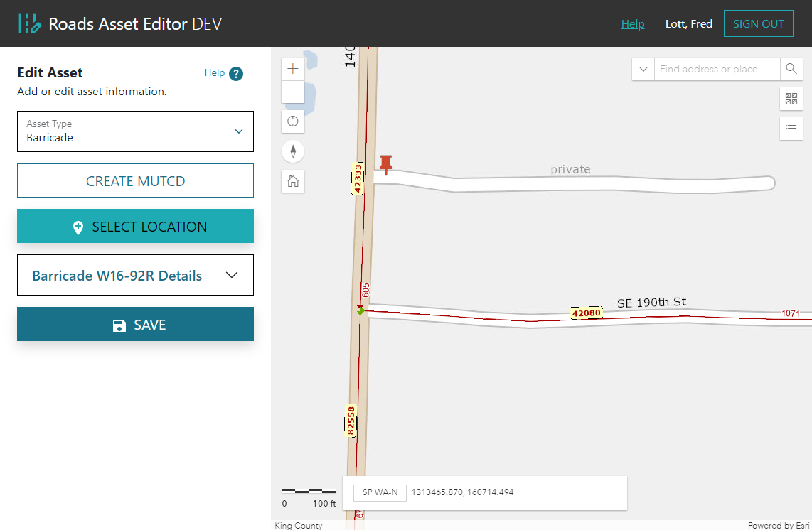
Interface slides (Fred)

Slide 16
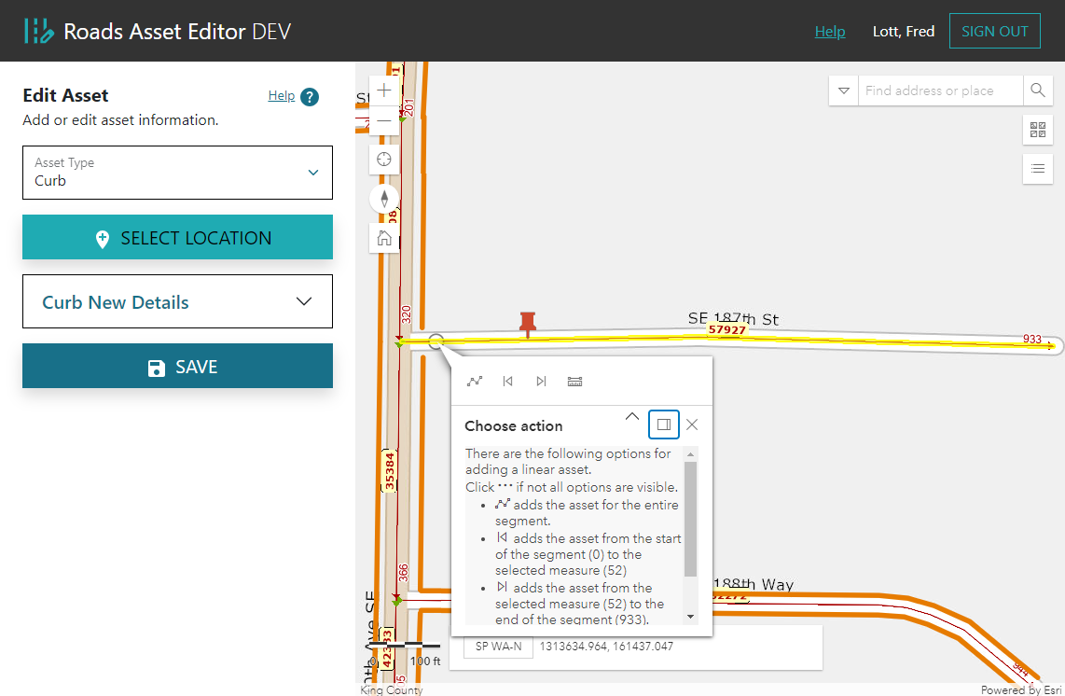
Interface slides (Fred)

Slide 17
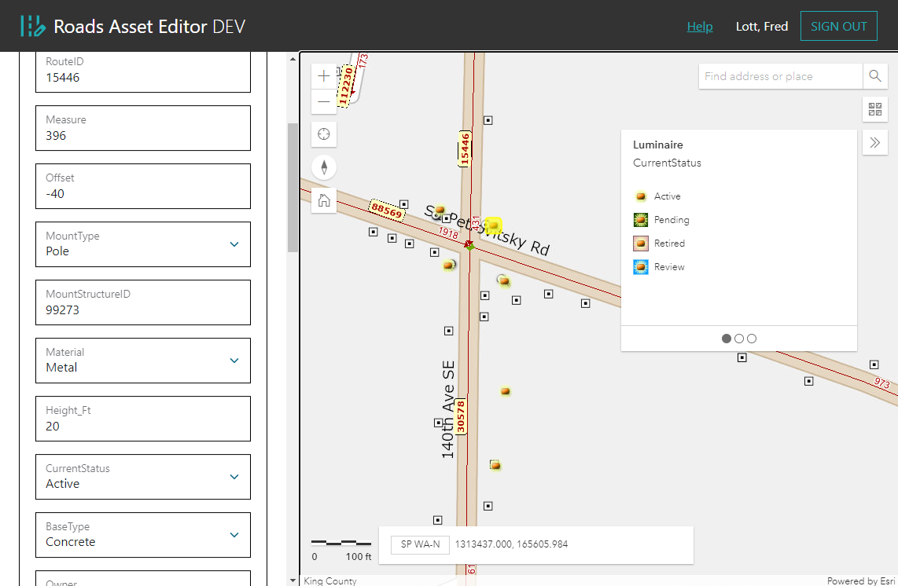
Interface slides (Fred)

Slide 18
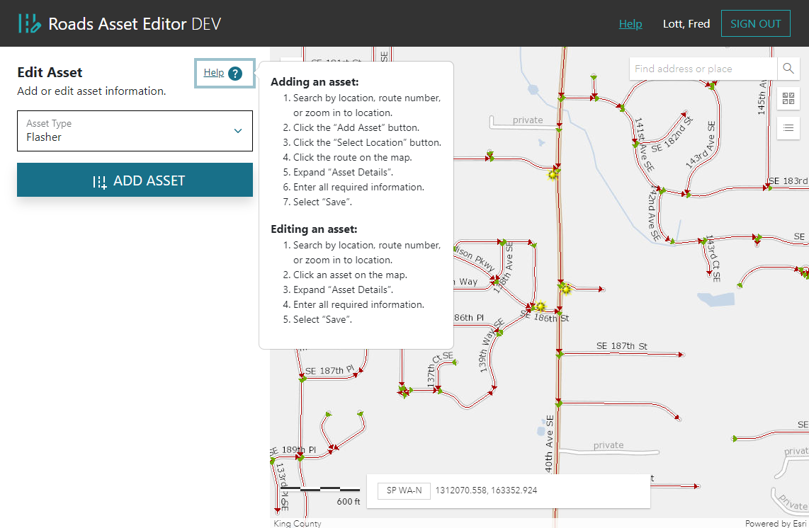
Interface slides (Fred)

Slide 19
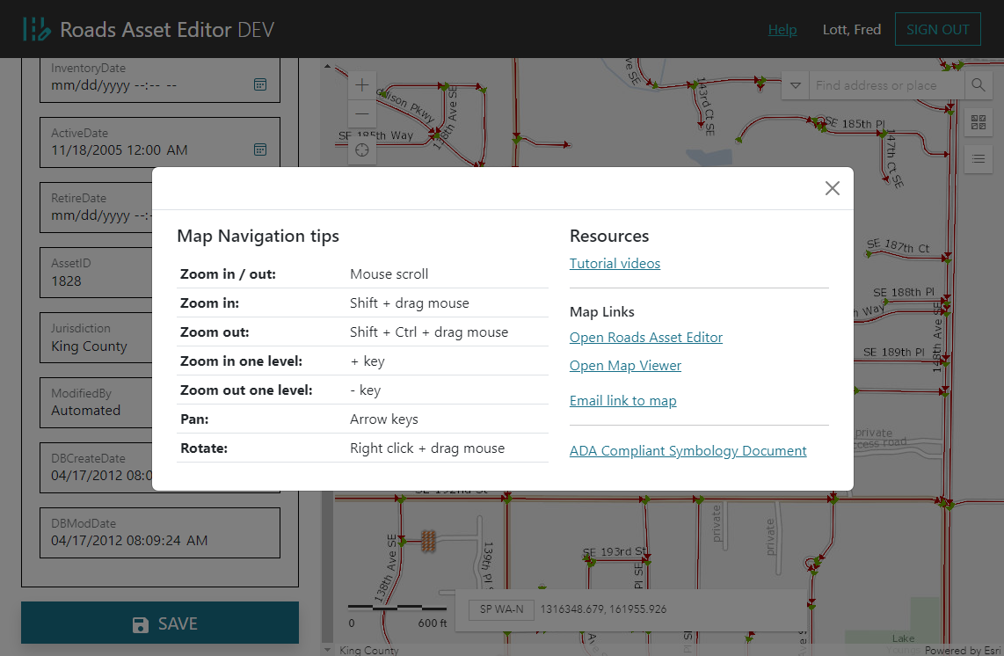
Interface slides (Fred)

Slide 20
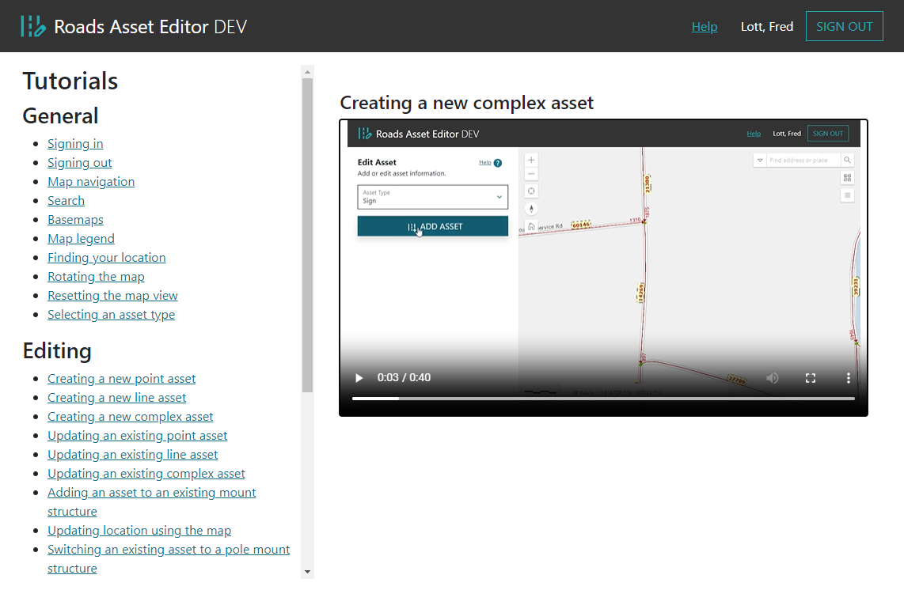
Interface slides (Fred)

Slide 21
Implementation details

Slide 22
Why Azure API Management (APIM)?
Meet KCIT security and compliance requirements
Put all the backend architecture and complexity of ArcGIS Enterprise and Enterprise Geodatabase on-premise access behind the API
Securely expose API operations for our front-end application
Simplify and reduce the cost of application integration
Make data and services re-usable and easily accessible

Slide 23
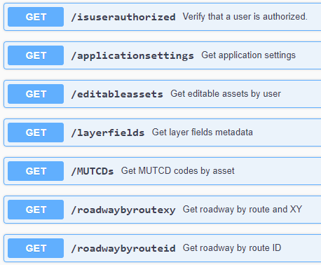
API Endpoints

Slide 24
🗺 Client-side Interactivity using React.js
ArcGIS.js is a traditionally structured Object-Oriented library.
React.js enforces a functional programming paradigm.
To resolve this conceptual mismatch, we isolated ArcGIS.js.
Data is provided to the map component using useState() hooks and useEffect() event handlers.
The map returns data to the other React components by calling the set() function exposed by each useState() hook when events (like a click) occur.

Slide 25
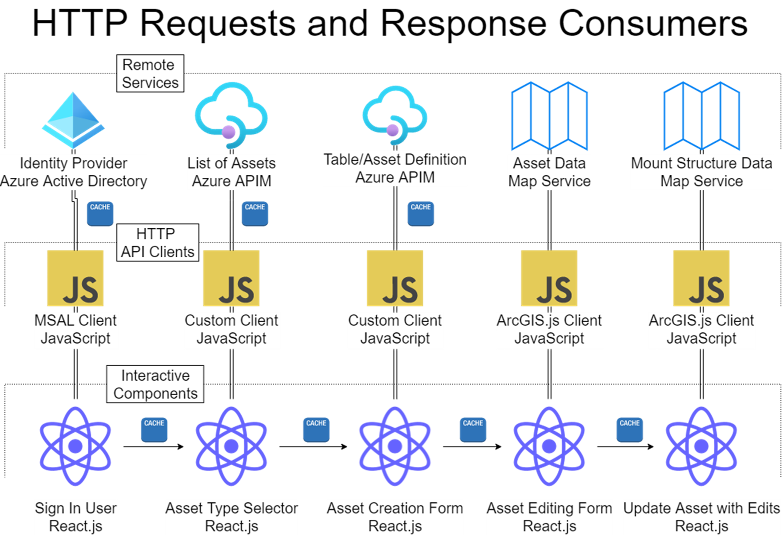

Slide 26
Closing Thoughts

Slide 27
Lessons learned
Thorough testing before launching any new features or updates
Use UAT scripts to test all functionality in test environment
Don’t push any updates before a big event
Keep documentation current
Make use of UX designer in the beginning

Slide 28
Questions ?
Tom Ryan tryan@kingcounty.gov
Fred Lott fred.lott@kingcounty.gov
Harkeerat Kang harkeerat.kang@kingcounty.gov
King County GIS Center
https://kingcounty.gov/gis/

Slide 29
Extra slides

Slide 30


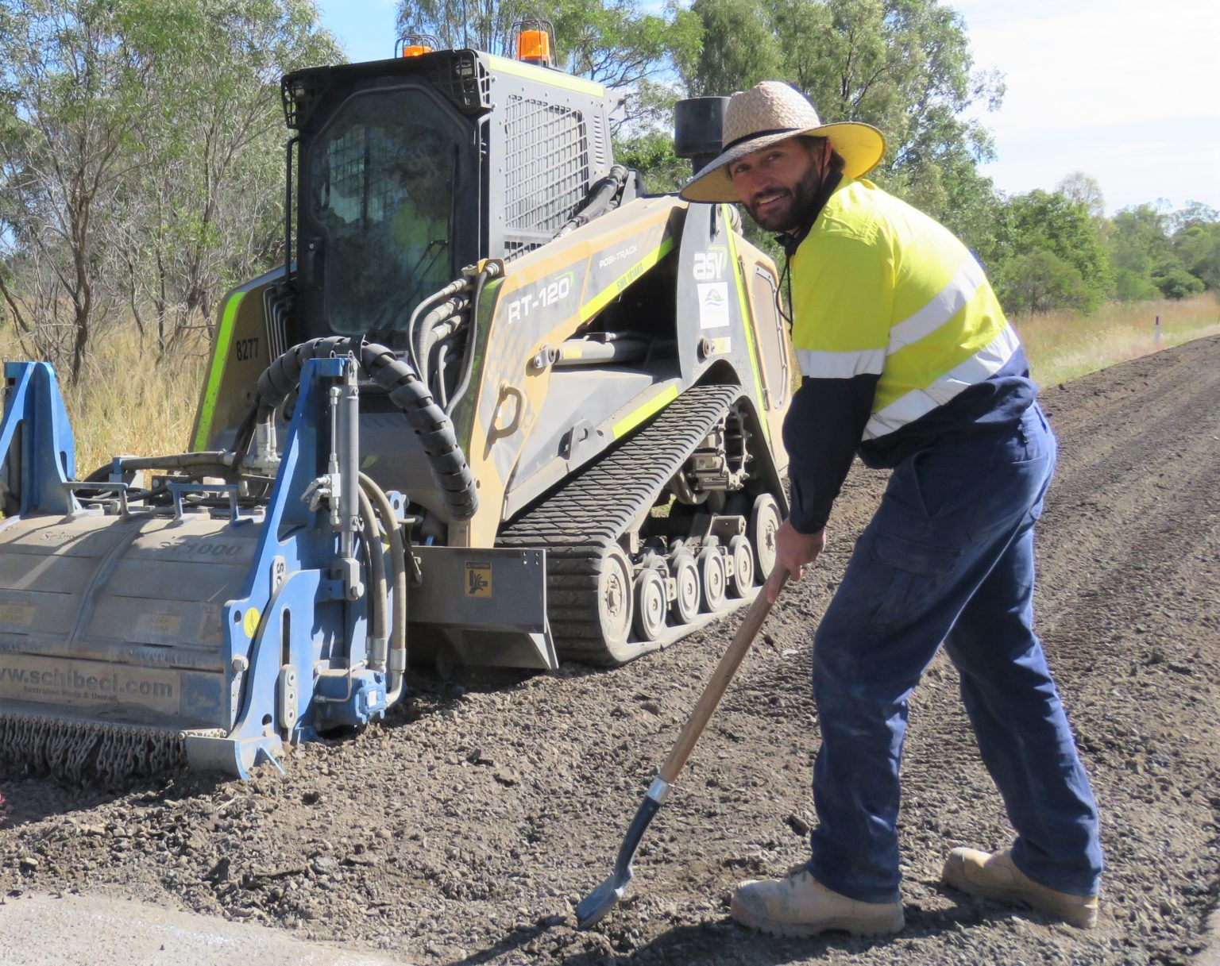
Personas
Tina the Traffic Engineer
Randy the Roads Asset Installer
Mary the Maintenance Specialist
Roads Asset Supervisors
Roads Data Stewards
Roads Work Planning
Sign Installers
Signal Technician
Pavement Striper
Sidewalk & Curb Installer
Landscape Architect
General maintenance
This Photo by Unknown Author is licensed under CC BY
This Photo by Unknown Author is licensed under CC BY

